Slide 1
Binomial Heaps

Slide 2
Binomial Heaps
The binomial tree B_{k} is an ordered tree defined recursively.
B₀
B₁
Bo
Bo
B₂
B1
B1

Slide 3
Binomial Trees
B₃
B2
B2
B₄
B3
B3

Slide 4
Binomial Trees
In general:
B_{k-1}
B_{k}
B_{k-1}
Properties for tree B_{k}:
There are 2^{k} nodes
The height of the tree is k
The number of nodes at depth i for i = 0…k is
The root has degree k which
is greater than any other node
k
i
k!
i!(k-i)!
= -------

Slide 5
Binomial Heaps
A binomial heap H is a set of binomials trees that satisfies the following binomial-heap properties:
Each binomial tree in H obeys the min-heap property.
For any nonnegative integer k, there is at most one binomial tree in H whose root has degree k.
Binomial trees will be joined by a linked list of the roots

Slide 6
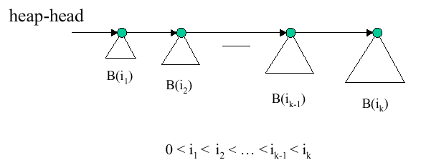
Binomial Heap Example
An n node binomial heap consists of at most Floor(lg n) + 1 binomial trees.

Slide 7
Binomial Heaps
How many binary bits are needed to count the nodes in any given Binomial Tree? Answer: k for B_{k}, where k is the degree of the root.
B₀ → 0 bits
B₁ → 1 bits
4
2
1
4
0
B₂ → 2 bits
B₃ → 3 bits
1
11
1
111
101
01
3
2
10
100
6
3
2
110
00
4
001
7
8
4
011
010
000
9

Slide 8
Binomial Heaps
Representing a Binomial Heap with 14 nodes
Head
2
1
1
<1110>
4
3
2
6
3
9
4
8
7
4
9
There are 14 nodes, which is 1110 in binary. This also can be written as <1110>, which means there is no B₀, one B₁, one B₂ and one B₃. There is a corresponding set of trees for a heap of any size!

Slide 9
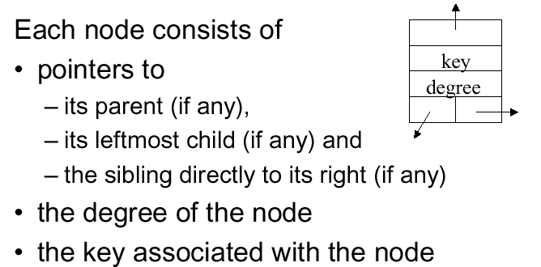
Node Representation

Slide 10
Binomial Heaps
z
Child
Parent
Parent
Parent
Sibling
Sibling
Child
Parent
Parent
Parent
Sibling
Sibling
Child
Parent

Slide 11
Create New Binomial Heap
Just allocate an object H, where
head[H] = NIL
Θ(1) runtime

Slide 12
Binomial Min-Heap
Walk across roots, find minimum
O(lg n)
Head
2
1
3
4
3
2
6
4
9
4
8
7
6
9

Slide 13
Binomial-Link(y,z)
1. p[y] ← z
2. sibling[y] ← child[z]
3. child[z] ← y
4. degree[z] ← degree[z] + 1
z
z becomes the parent of y
y
Link binomial trees with the same degree. Note that z, the second argument to BL(), becomes the parent, and y becomes the child.
z
y
z
y
z
y
Θ(1) Runtime

Slide 14
Binomial-Heap-Union(H₁, H₂)
H ← Binomial-Heap-Merge(H₁, H₂)
  This merges the root lists of H₁ and H₂ in increasing order of root degree
Walk across the merged root list, merging binomial trees of equal degree. If there are three such trees in a row only merge the last two together (to maintain property of increasing order of root degree as we walk the roots)
Concept illustrated on next slide; skips some implementation details of
cases to track which pointers to change
Runtime: Merge time plus Walk Time: O(lg n)

Slide 15
Starting with the following two binomial heaps:
2
60
80
18
32
63
93
58
19
53
69
Merge root lists, but now we have two trees of same degree
60
80
2
18
93
32
63
58
19
53
69
60
80
2
Combine trees of same degree using binomial link, make smaller key the root of the combined tree
93
18
32
63
58
19
53
69

Slide 16
Binomial-Heap-Insert(H)
To insert a new node, simple create a new Binomial Heap with one node (the one to insert) and then Union it with the heap
1. H’ ← Make-Binomial-Heap()
2. p[x] ← NIL
3. child[x] ← NIL
4. sibling[x] ← NIL
5. degree[x] ← 0
6. head[H’] ← x
7. H ← Binomial-Heap-Union(H, H’)
Runtime: O(lg n)

Slide 17
Binomial-Heap-Extract-Min(H)
With a min-heap, the root has the least value in the heap.
Notice that if we remove the root from the figure below, we are left with four heaps, and they are in decreasing order of degree. So to extract the min we create a root list of the children of the node being extracted, but do so in reverse order. Then call Binomial-Heap-Union(..)
Broken into separate Binomial Trees after root’s extraction
Part of original heap showing binomial tree with minimal root.
H
Reversal of roots, and combining into new heap
Runtime: Θ(lg n)

Slide 18
Heap Decrease Key
Same as decrease-key for a binary heap
  Move the element upward, swapping values, until we reach a position where the value is ≤ key of its parent
Runtime: Θ(lg n)

Slide 19

Heap Delete Key
Set key of node to delete to –infinity and extract it:
Runtime: Θ(lg n)

